Slide 1



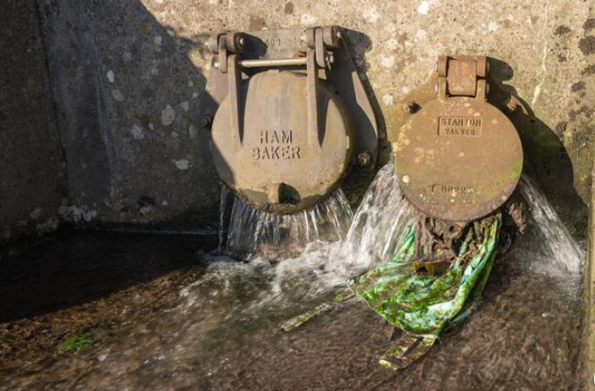

HYBRID RULE-BASED DETECTION FRAMEWORK
GROUP 3
Amaar, Dayum, Ebrima, Shivanghi, Jahnavi

Slide 2




PROBLEM CONTEXT
OBJECTIVES
Develop interpretable alerting algorithm
  Sewer blockages cause flooding and environmental damage
  Need early detection
  Rainfall complicates detection
  Client wants automated alert generation.
The main challenge is distinguishing real blockages from rainfall-driven level increases.
Site-specific detection
Rainfall-aware filtering
Generate structured alerts

Slide 3
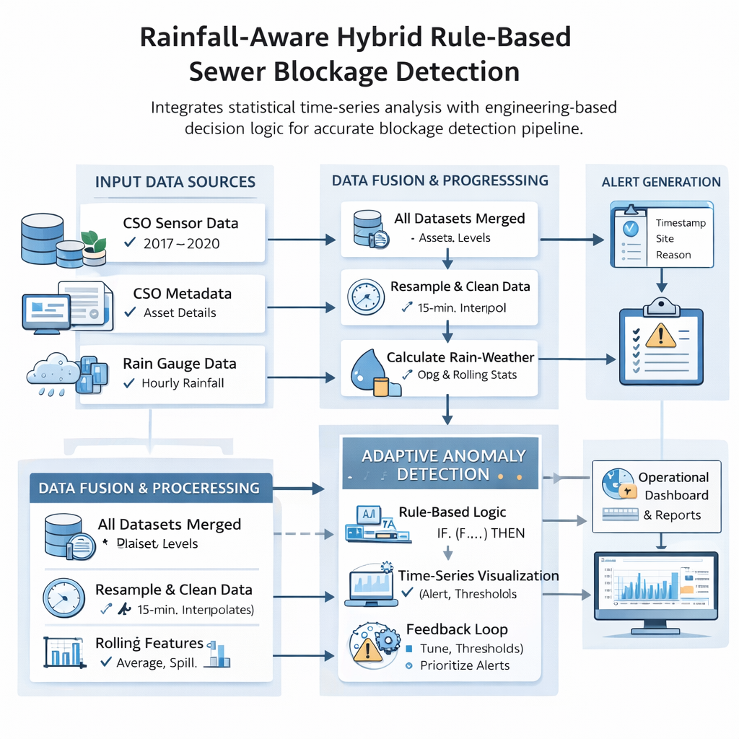
SOLUTION
We designed a rainfall-aware hybrid rule-based detection framework that integrates statistical time-series analysis with engineering-based decision logic. The approach is designed to distinguish genuine blockage behaviour from rainfall-driven fluctuations, ensuring reliable alert generation.
85%
SALES

Slide 4
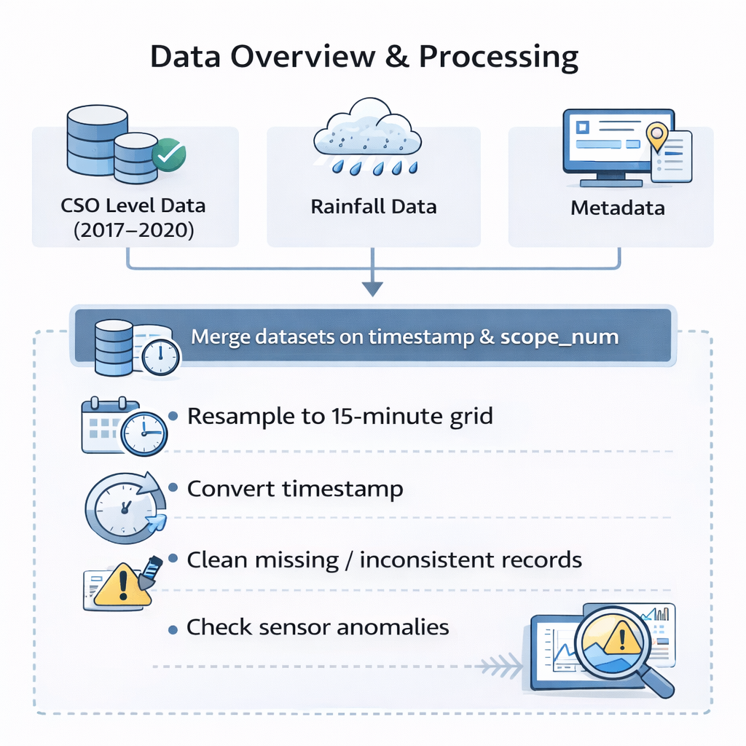
DATA OVERVIEW
  CSO Level Data (2017–2020)
  Rainfall Data
  Metadata

Slide 5
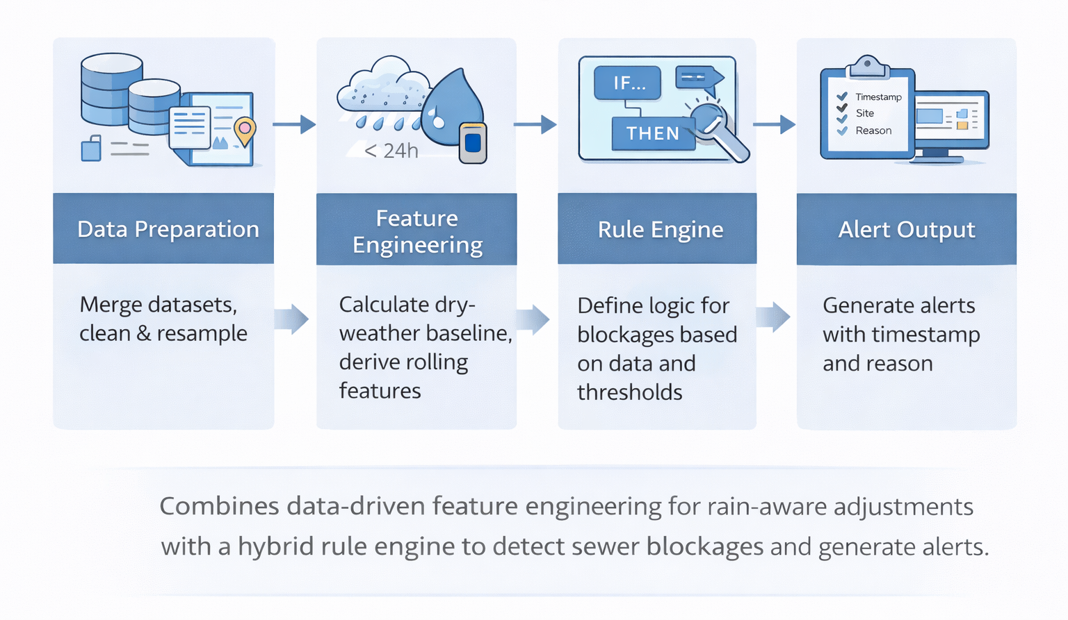
METHODOLOGY

Slide 6
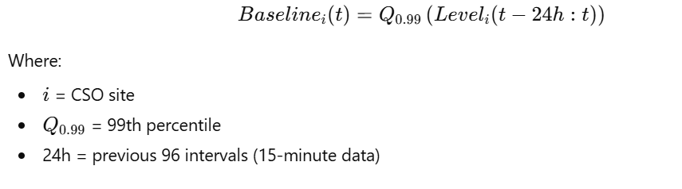
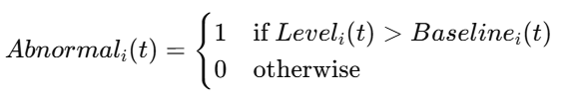
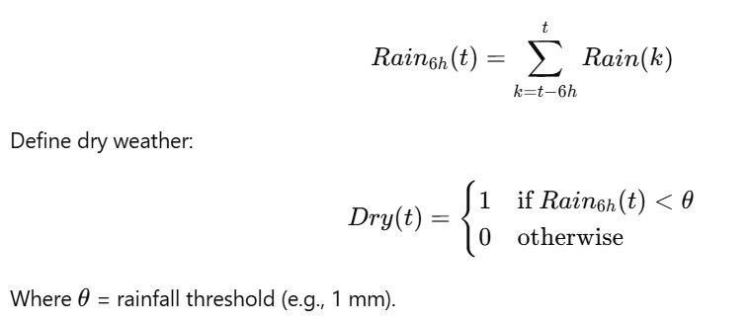
DETECTION LOGIC & BASELINE
ROLLING PERCENTILE BASELINE
ABNORMAL LEVEL DETECTION
DRY-WEATHER FILTERING
PERSISTENCE RULE

Slide 7
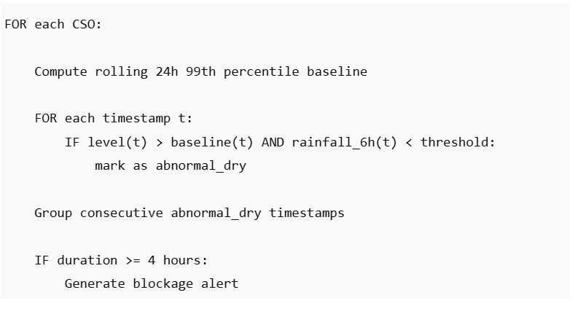
BLOCKAGE DETECTION ALGORITHM

Slide 8
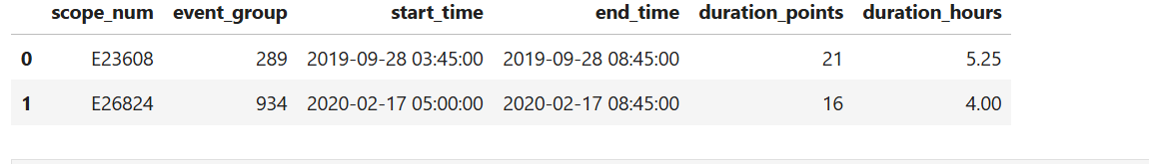
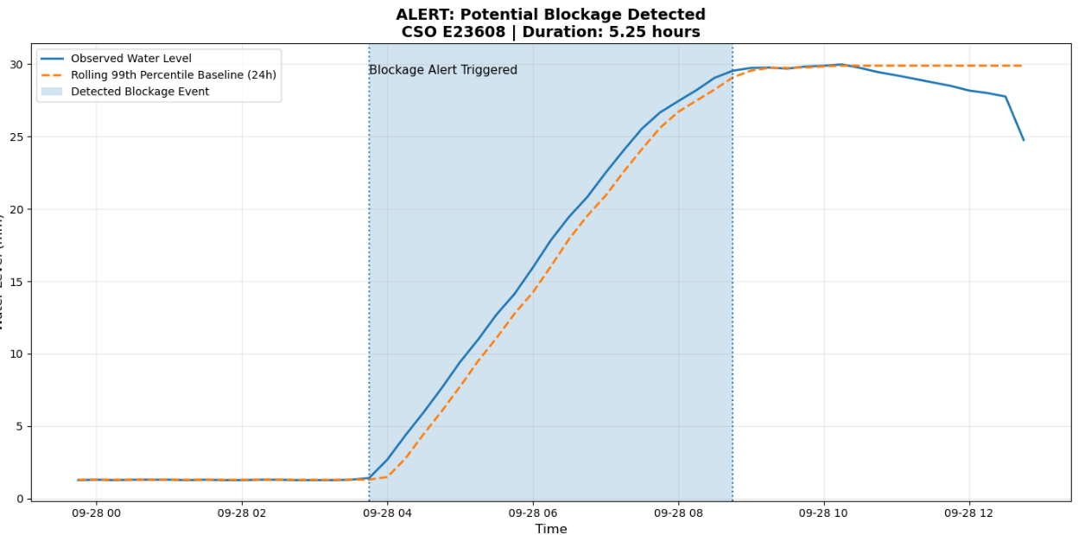
ALERT DETECTION PLOT
Figure X demonstrates one such alert event.
Algorithm detected sustained abnormal dry-weather conditions.

Slide 9
LIMITATIONS
STRENGTHS
  1. Parameter sensitivity (4-hour persistence may require tuning).
  2.Extreme long rainfall events could still affect baseline adaptation.
  Does not predict future blockages; it detects ongoing ones
  No Training Data
  Interpretable
  No training data
  Scalable
FUTURE IMPROVEMENT
  Incorporating flow rate data
  Machine learning-based predictive modelling
  Seasonal baseline adjustments

Slide 10
CONCLUSION
  A rainfall-aware hybrid rule-based detection framework was developed.
  The system applies adaptive rolling statistical baselines per CSO site.
  Rainfall filtering and persistence logic reduce false alarms.
  Structured blockage alerts are generated with start time, end time, and duration.
  The framework is interpretable, scalable, and suitable for operational deployment
THANK YOU

