Slide 1


PREDICTING LENDER APPROVAL DECISIONS AND OPTIMIZING BROKER ROUTING USING MACHINE LEARNING
Group 3
Ammar , Daayum, Ebrima, Shivanghi

Slide 2




PROBLEM STATEMENT
OBJECTIVES
This project aims to
A financial broker must decide which lender to send the loan application to. However, the lenders must apply different approach criteria and risk policies
Develop Machine learning models to predict lender approval decisionm
Challenge
Extract lender decision rules from the data
  High rate of loan rejections
  Lost revenue opportunities for the broker
  Poor Borrower-lender mismatching
  Unneccesary credit checks
Proposed an Intelligent routing strategy for the broker
Key Question
How can brokers use data and machine learning to predict lender approval decisions and route applications more intelligently?
To identify key predictors that influence lenders' decisions

Slide 3
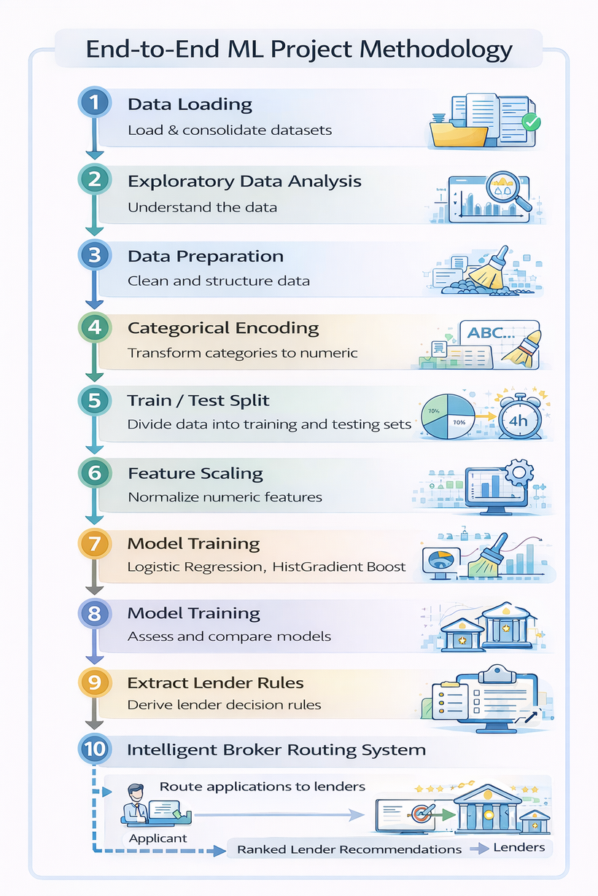
EXPLORATORY DATA ANALYSIS
Three variables strongly influence approval decisions:
DEBT-TO-INCOME RATIO (DTI)
Higher DTI indicates greater financial leverage and reduces approval probability.
CREDIT UTILISATION RATIO
High utilisation suggests heavy reliance on credit and increased financial risk
MISSED PAYMENT HISTORY
Higher DTI indicates greater financial leverage and reduces approval probability.
OBSERVATION
Lenders appear to use risk thresholds when evaluating loan applications.

Slide 4
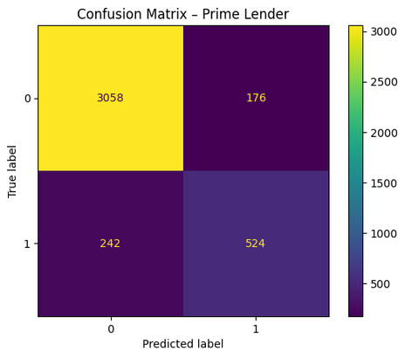
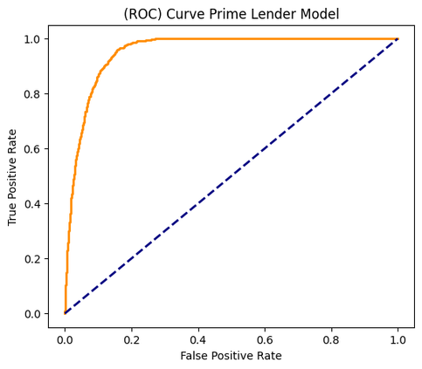
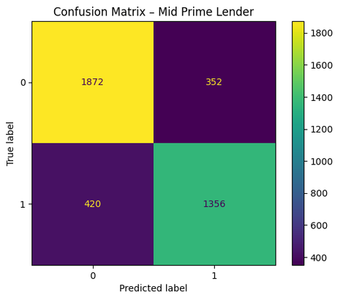
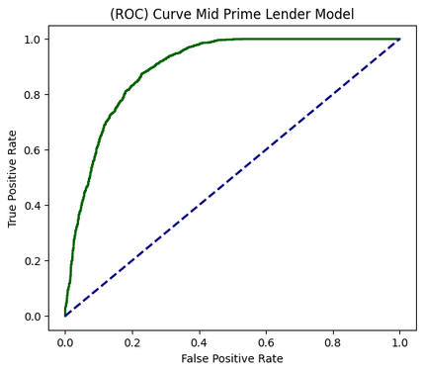
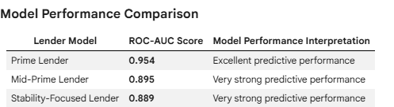
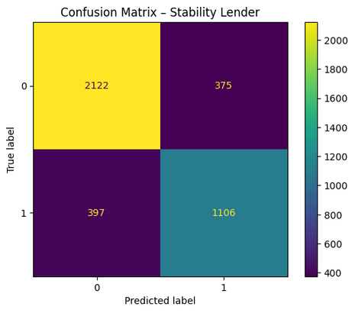
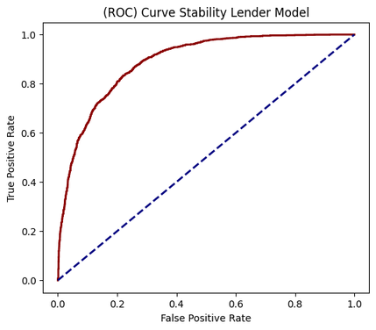
PREDICTIVE MODELLING- LOGISTICS REGRESSION
Model performance was measured using ROC-AUC, which evaluates how well the model distinguishes between approved and rejected applications.

Slide 5
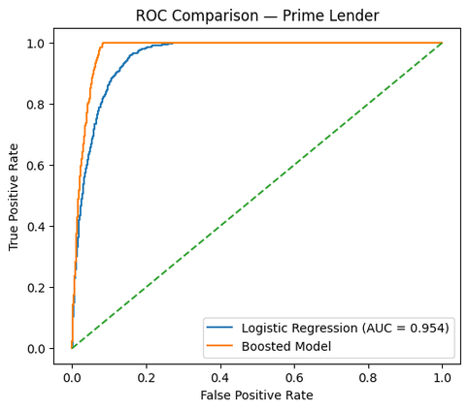
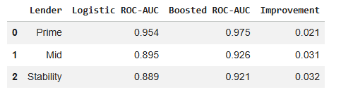
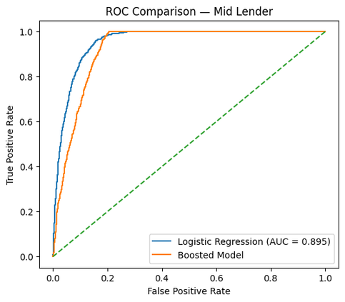
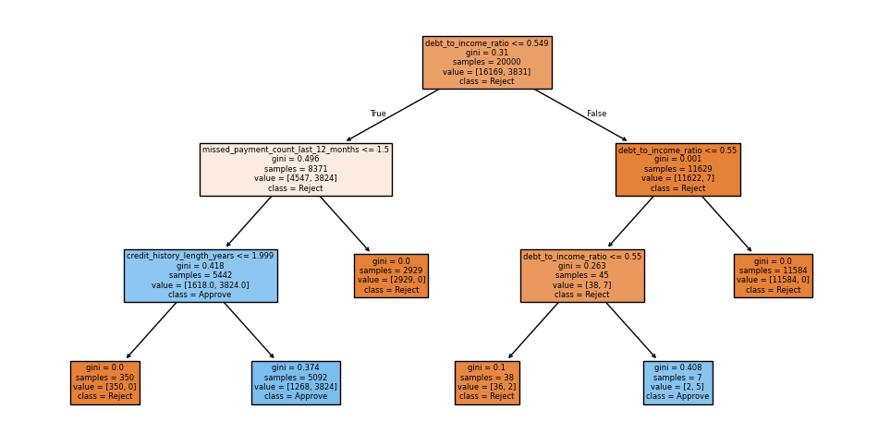
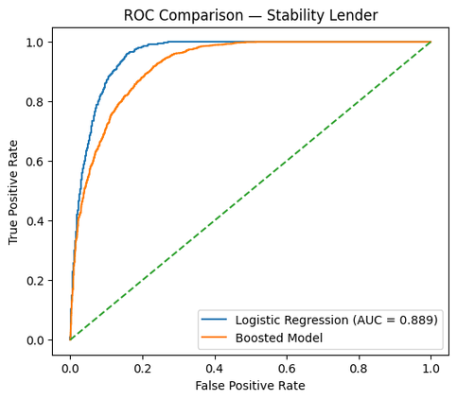
IMPROVED MODEL- HISTGRADIENT BOOST
MODEL PERFORMANCE & COMPARASION
Prime- Lender
Decision Trees to Correct Errors of the Previous Trees
Mid- Lender
Stability- Lender

Slide 6
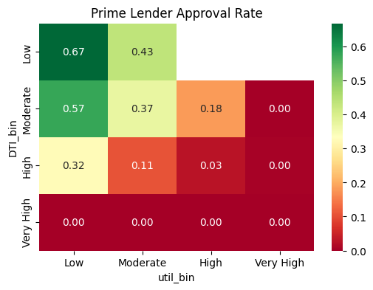
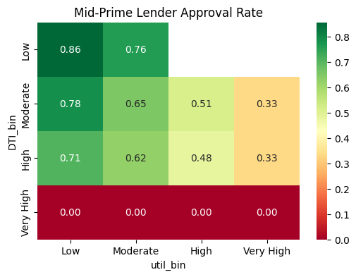
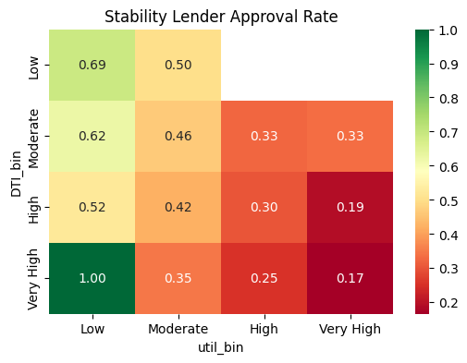
LENDER DECISION RULES
Heatmaps showing approval rates by DTI and credit utilisation
Analysis of approval probabilities reveals key decision rules
Prime lender
  Rejects borrowers with DTI > ~0.9
  Rejects borrowers with 2+ missed payments
Mid lender
  Rejects borrowers with DTI > ~0.9
  Rejects borrowers with 3+ missed payments
Stability lender
  Rejects borrowers with 3+ missed payments
  Rejects borrowers with DTI > ~0.9 and credit_Util > 0.9

Slide 7

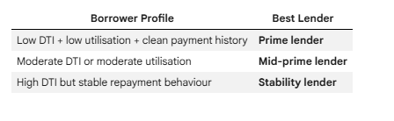

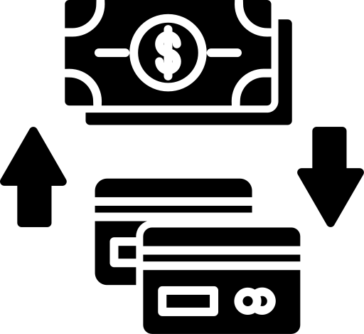

INTELLIGENT ROUTING STRATEGY
BUSINESS IMPACT
Benefits for Brokers and Borrowers
Optimizing Loan Application Routing. Machine learning predictions allow brokers to estimate:
Increase first-time loan approvals
Reduce unnecessary credit checks
Improve borrower–lender matching
Applications can then be routed to the lender with the highest predicted approval probability.
Improve broker operational efficiency
This creates a data-driven decision support system for loan brokerage.

Slide 8
CONCLUSION
This project demonstrates how machine learning can improve decision-making in financial brokerage.
Key findings:
  Borrower leverage and repayment behaviour strongly influence lender decisions
  Predictive models can accurately estimate approval probabilities
  Boosted models capture complex risk relationships
  Intelligent routing strategies can significantly improve broker performance
Final Insight
Machine learning can transform traditional brokerage processes into data-driven decision systems.

